Slide 1
[Student Non-competitive]
Poster Title
Poster Author Name(s)
Faculty/Staff Advisor Name(s)
College Name*
School Name and/or Department Name
University of Bridgeport, Bridgeport, CT
Purpose, Aims, Objectives:
Methods/Theoretical Framework:
Discussion, Conclusion, Implications and Limitations:
Narrative/figure/table.
State your research/ innovative project, objectives and hypothesis (where applicable).
What key things are you hoping to learn?
Explain the justification for and significance of the study/project.
(Insert pictures, figures, or examples where relevant to enhance your poster)
Narrative/figure/table
This information makes up the main “body” of the poster.
What are your main arguments?
Share them here in a manner that is clear and concise.
How was your research framed or innovative project designed?
Describe the methodological approach to research your objectives or innovative process/business plan you developed.
Describe and defend the methods and/or theoretical approaches that are used.
Presenter addresses how this approach answers the chosen research question.
(Insert pictures, figures, or examples where relevant to enhance your poster)
Narrative/figure/table
Make your concluding remarks. You may relate back to the key questions and objectives you stated at the beginning. Did you find anything unexpected? What future direction might this research take? Are there any new questions that have come to light?
Shows how results or arguments address the question(s).
Clearly explains results or outcome of the work to an interdisciplinary audience.
Explains why the work is important in a larger context.
Identify limitations of the work.
Background Information:
Analysis/Results/Outcomes:
Introduces the background to an interdisciplinary audience.
Explains why this endeavor is needed to fill gaps or add to existing knowledge.
State your research/project data that was produced.
Explain clearly what was found after the chosen methodology/framework was utilized for this project.
Analysis technique is completely described within the context of each finding.
(Insert pictures, figures, or examples where relevant to enhance your poster)
References
References cited in the poster content.
Use APA 7th edition (or MLA, if applicable) format.
IRB # (If applicable)
If your research/project involved study participants, include your IRB # in this format XXXX-XX-XX.
If you are a non-UB poster submitter, please insert the appropriate logo, school institution name, and location in Connecticut.
BEFORE SUBMITTING YOUR POSTER, DELETE SECTIONS HIGHLIGHTED IN YELLOW AS NEEDED.

Slide 2
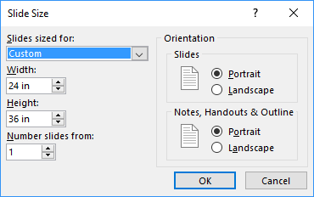
KEY TAKE AWAYS FOR STUDENT NON-COMPETITIVE
POSTER SUBMISSION
Use appropriate font and size (bigger, better)
Color and images are acceptable
Customize Additional Text Boxes, as needed
Review poster for correct spelling, punctuation before submitting on-line
Poster Slide Size must be width 24 in and height to 36 in
Click “Design -> Slide Size -> Custom Slide Size
Select all parameters as shown in the image below:

